Slide 1



Department of Computer Science and Engineering
GESTURE MATE
SRIRAM V.S -211419104267
RAGHUL SADAGOBAN S - 211419104207
YAZHINIA KUMARAN I - 211419104313
Guide Name & Designation :
Mrs. A. KANCHANA M.E Assistant Professor
Coordinator Name & Designation
Mr. M. MOHAN, M.E.,(PH.d.)

Slide 2
Introduction
The paper proposes an AI virtual mouse system that utilizes hand gestures and hand tip detection for performing mouse functions on a computer using computer vision. The system aims to replace traditional mouse devices by using a built-in camera or webcam to track fingertip movement and perform mouse cursor operations and scrolling functions. Python programming language and OpenCV library are used in the system, along with MediaPipe, Pynput, Autopy, and PyAutoGUI packages. The proposed model achieves high accuracy levels and can work well in real-world applications without the use of a GPU.

Slide 3
Objective of the Project
Using the current system even-though there are a number of quick access methods available for the hand and mouse gesture for the laptops, using our project we could make use of the laptop or web-cam and by recognizing the hand gesture we could control mouse and perform basic operations like mouse pointer controlling, select and deselect using left click, and a quick access feature for file transfer between the systems connected via network LAN cable. The project done is a “Zero Cost” hand recognition system for laptops, which uses simple algorithms to determine the hand, hand movements and by assigning an action for each movement. But we have mainly concentrated on the mouse pointing and clicking actions along with an action for the file transfer between connected systems by hand action and the movements.

Slide 4
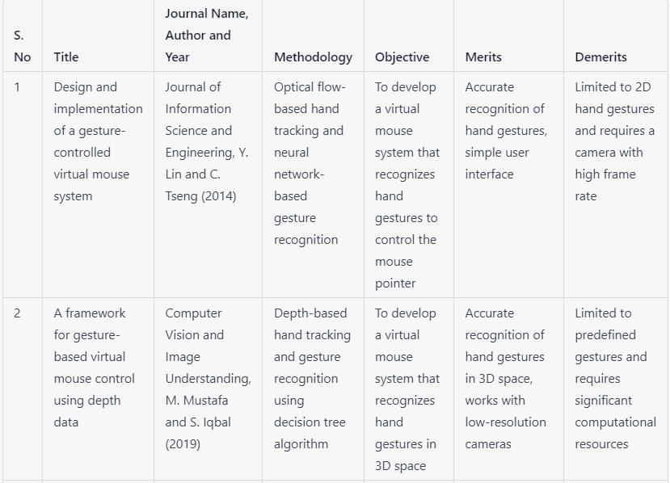
Literature Survey

Slide 5
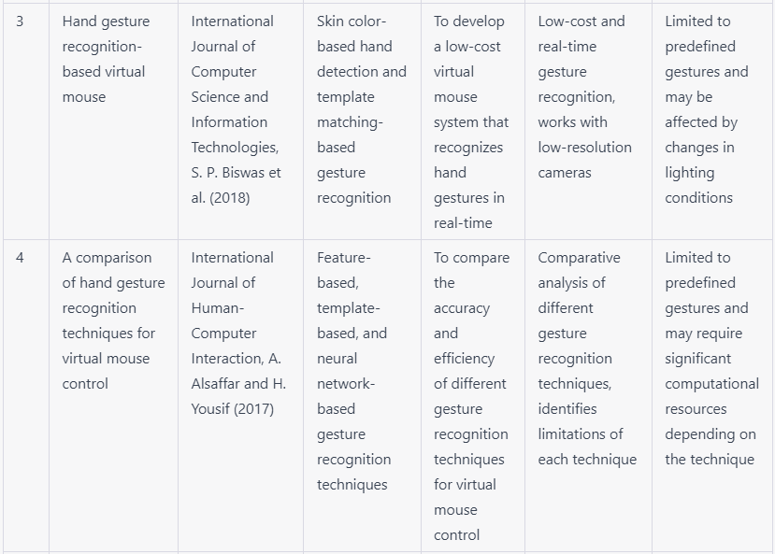
Literature Survey

Slide 6
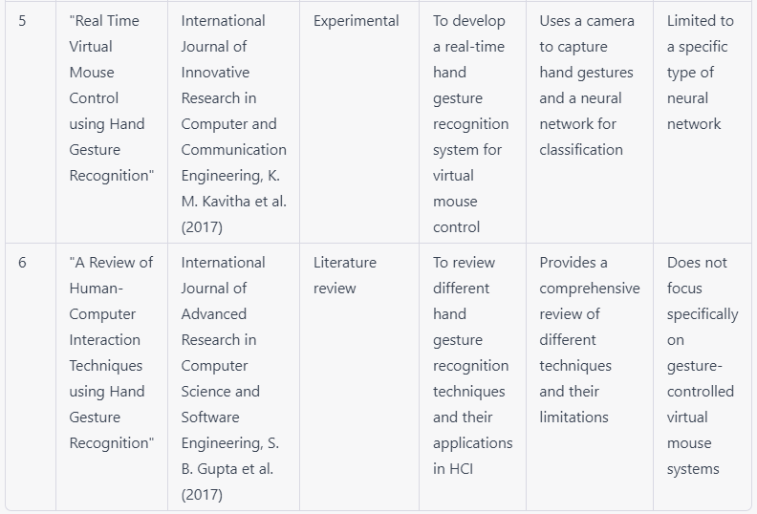
Literature Survey

Slide 7
Problem Statement
Traditional methods of controlling slides, such as using a physical mouse or keyboard, can be cumbersome and distracting for the presenter.
Gesture control technology can provide a more intuitive and seamless way to navigate through slides during presentations.
Current gesture control technology can be expensive and not accessible to everyone.
The development of an affordable and user-friendly gesture-controlled virtual mouse for slide presentations would improve the overall user experience.
The final product should be easy to set up and use, with clear instructions and minimal technical requirements.

Slide 8
Proposed System
Using the current system even-though there are a number of quick access methods available for the hand and mouse gesture for the laptops, using our project we could make use of the laptop or web-cam and by recognizing the hand gesture we could control mouse and perform basic operations like mouse pointer controlling, select and deselect using left click, and a quick access feature for file transfer between the systems. The project done is a “Zero Cost” hand recognition system for laptops, which uses simple algorithms to determine the hand movements and by assigning an action for each movement. But we have mainly concentrated on the mouse pointing and clicking actions along with an action for the file transfer between connected systems by hand action and the movements.

Slide 9
Software / Hardware used
HardWare:
Software:
Webcam
laptop or Pc
1.Python
2.Anaconda
3. VS code
4. Javascript

Slide 10
Architecture / Methodology used
Hardware: A laptop or desktop computer with a built-in or external webcam for capturing hand gestures.
Software: The system would consist of several software components: a. Image processing software: This component would be responsible for capturing and processing images from the webcam, isolating the hand region, and segmenting the hand from the background. b. Gesture recognition software: This component would analyze the segmented hand region and identify hand gestures using machine learning or computer vision algorithms. c. Virtual mouse software: This component would translate the detected hand gestures into mouse movements, clicks, and other actions. It would also include features such as cursor speed and sensitivity control, and left/right-hand switching.

Slide 11
Architecture / Methodology used
3. User Interface: The system would have a simple and intuitive user interface that allows users to control the virtual mouse using their hand gestures. The user interface would also allow users to customize the gesture recognition parameters and virtual mouse settings to suit their preferences.
4. Networking: The system could include networking capabilities to enable file transfer between connected systems via LAN cable.
Overall, this allows users to control their computer using simple hand gestures, providing a more natural and ergonomic way of interacting with their computer. The system would be flexible and customizable, allowing users to adjust the settings to meet their specific needs.

Slide 12
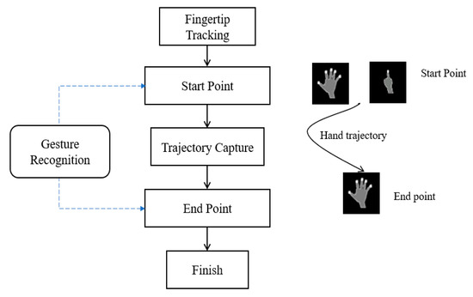
System Design - UML diagram

Slide 13
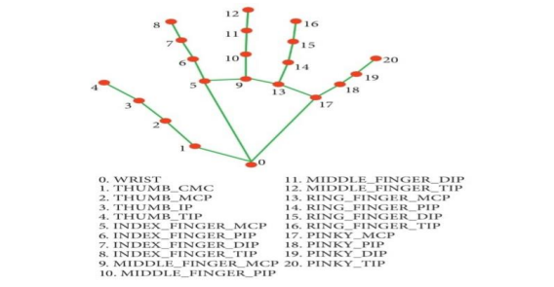
System Design - Modular diagram:

Slide 14
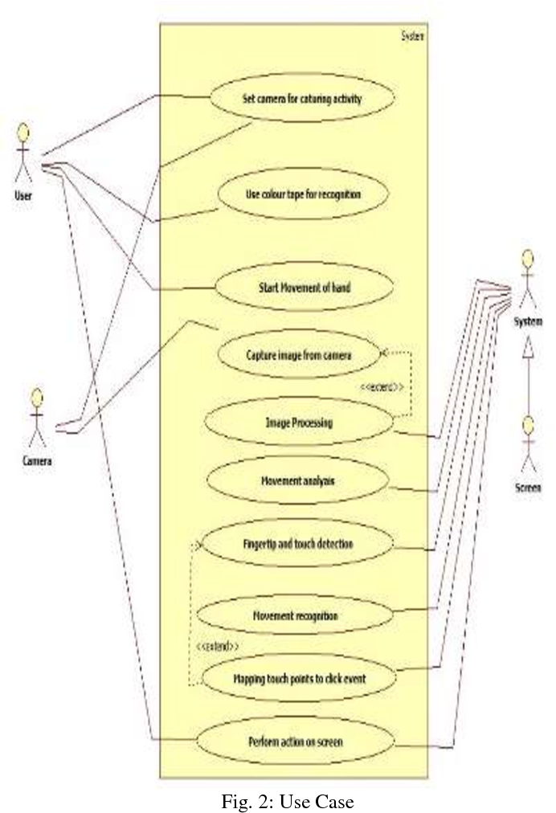
System Design - Use case diagram:

Slide 15
Module Description
Gesture Recognition Module:
This module is responsible for recognizing the gestures made by the user. The module uses sensors or cameras to capture the hand movements of the user, and then processes the data to identify the intended gesture.
Mapping Module:
This module maps the recognized gesture to a corresponding action. For example, a specific gesture may be mapped to the action of moving the cursor up or down, left or right. Cursor Control Module: This module takes the actions identified by the mapping module and controls the movement of the cursor accordingly. It may use algorithms such as the Kalman filter to smooth out the cursor movement and improve accuracy.

Slide 16
Module Description
Click Control Module:
This module is responsible for detecting the user's intention to click or double-click. It may use a variety of techniques such as analyzing the hand movement speed, time between clicks, or finger positions to determine the intended action.
Feedback Module:
This module provides feedback to the user to indicate that their actions have been recognized and executed correctly. It may use visual or auditory cues such as sound effects or cursor changes to provide feedback.

Slide 17
Module Description
User Interface Module:
This module provides a graphical user interface for the user to interact with the system. It may display the current cursor position, provide options for adjusting sensitivity or gesture recognition settings, or allow the user to switch between different modes of operation.
Overall, the gesture-controlled virtual mouse system works by capturing the user's hand movements, recognizing the intended gesture, mapping it to a corresponding action, and then controlling the cursor accordingly. The system provides feedback to the user to indicate that their actions have been recognized and executed correctly

Slide 18
Testing /Performance Evaluation / Results
An AI system utilizing computer vision to improve human-computer interaction is proposed in the proposed visual mouse AI system. Because of the limited number of data sets available, it is difficult to compare contradictory outcomes of testing of visual AI mouse systems. A total of 600 hand-labeled touches were obtained through this test, which was performed 25 times by four people in different lighting conditions and at
different distances from the screen, and each person tested the visual mouse system individually. In Table 1, the results of 10 AI tests performed in normal light conditions, 5 AI tests performed in dim light, 5 AI tests performed near the webcam, and 5 AI tests performed at a distance from the webcam are tabulated.

Slide 19
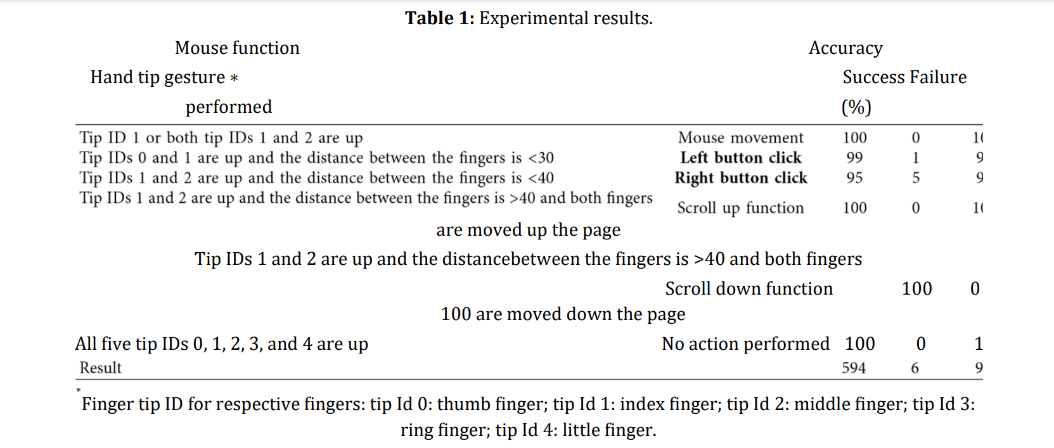
Testing /Performance Evaluation / Results

Slide 20
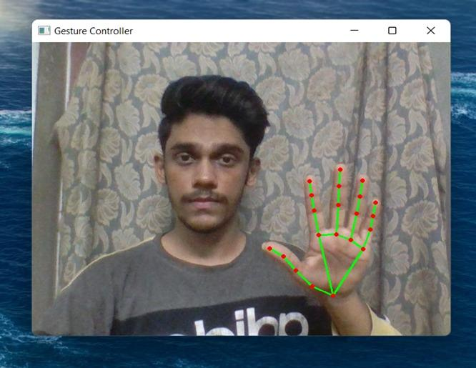
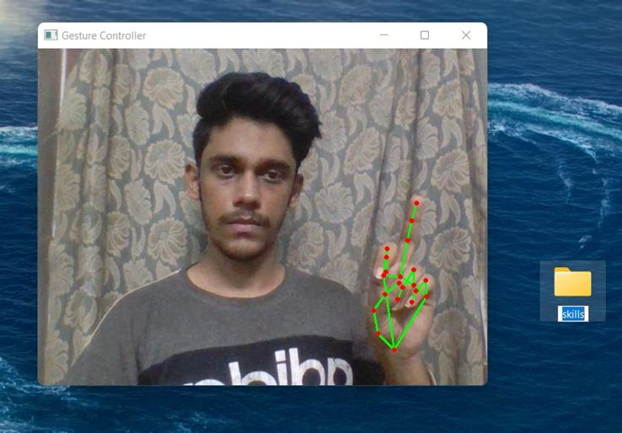
Screen Shots
Neutral Gesture:
Left Click:

Slide 21
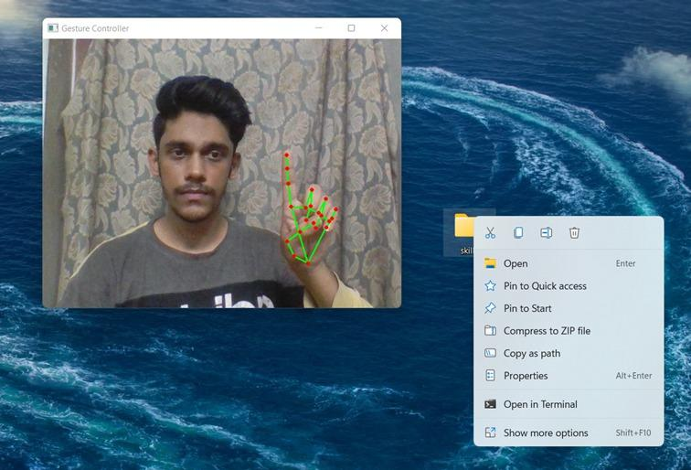
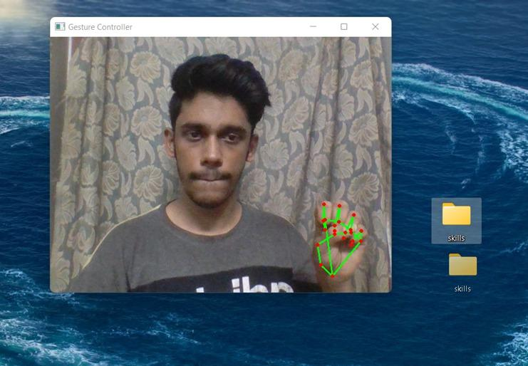
Screen Shots
Right Click:
Drag and Drop:

Slide 22
Conclusion / Feature Enhancement
From the results of the model, we can come to a conclusion that the proposed AI virtual mouse system has performed very well and has a greater accuracy compared to the existing models and also the model overcomes most of the limitations of the existing systems. Since the proposed model has greater accuracy, the AI virtual mouse can be used for real-world applications, and also, it can be used to reduce the spread of COVID-19, since the proposed mouse system can be used virtually using hand gestures without using the traditional physical mouse.
The model has some limitations such as small decrease in accuracy in right click mouse function and some difficulties in clicking and dragging to select the text. Hence, we will work next to overcome these limitations by improving the finger tip detection algorithm to produce more accurate results.

Slide 23
Reference Paper/ URL
[1] Abhik Banerjee, Abhirup Ghosh, Koustuvmoni Bharadwaj,” Mouse Control using a Web Camera based on Color Detection”,IJCTT,vol.9, Mar 2014.
[2] Angel, Neethu.P.S,”Real Time Static & Dynamic Hand Gesture Recognition”, International Journal of Scientific & Engineering Research Volume 4, Issue3, March-2013.
[3] Q. Y. Zhang, F. Chen and X. W. Liu, “Hand Gesture Detection and Segmentation Based on Difference Background Image with Complex Background,” Proceedings of the 2008 International Conference on Embedded Software and Systems, Sichuan, 29-31 July 2008, pp. 338- 343.
[4] D. L. Quam, “Gesture recognition with a Data Glove,” IEEE Conference on Aerospace and Electronics, vol.

Slide 24
Reference Paper/ URL
[5] Danckert, J., Goodale, M.A., 2001. Superior performance for visually guided pointing in the lower visual field. Exp. Brain Res. 137, 303–308. https://doi.org/10.1007/s002210000653.
[6] Carlton, B., 2021. Hapt X Launches True-Contact Haptic Gloves For VR And Robotics. VR Scout. URL https://vrscout.com/news/haptx-truecontact-haptic-gloves-vr/ (accessed 3.10.21).
[7] Brenton, H., Gillies, M., Ballin, D., Chatting, D., 2005. D.: The uncanny valley: does it exist, in: In: 19th British HCI Group Annual Conference: Workshop on Human-Animated Character Interaction
[8] Buckingham, G., Michela kakis, E.E., Cole, J., 2016. Perceiving and acting upon weight illusions in the absence of somatosensory information. J. Neuro physiol. 115, 1946–1953. https://doi.org/10.1152/jn.00587.2015.

Slide 25
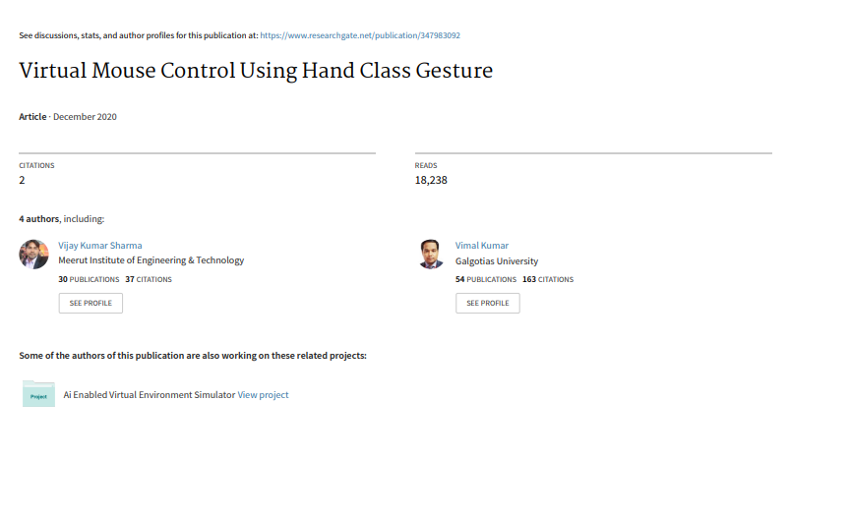
Conference / Publication / Project Contest Winner Certificates

